Slide 1

Artificial intelligence project by Shyam sunder reddy beeram (00750113) Priyanka nandigam(00748972) Sridevi jaidi(00754304)
Spring ‘22

Slide 2
Breast cancer prediction
Using Deep Learning Techniques
[CNN,Flask Integration,Numpy,open CV,TensorFlow,Keras]

Slide 3
Project Statement
The goal is to classify images into two classifications of malignant and benign. As early diagnostics significantly increases the chances of correct treatment and survival. In this application, we are helping the doctors and patients to classify the Type of Tumour for the specific image given with the help of Neural Networks.
Model can be extended to:
>We Design a Web application to identify.
And this is User friendly.

Slide 4
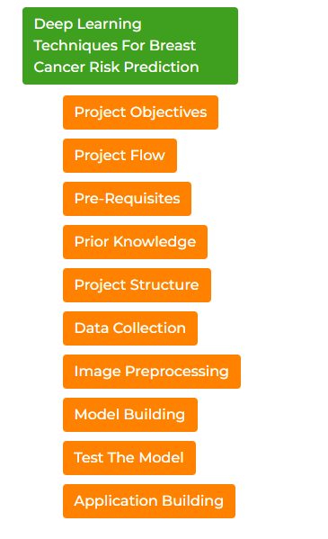
Approach

Slide 5
Deliverables
A python code of a fully trained model which can identify upon uploading an image in the software.
Whole set of project consisting Test& Train Data sets.
Some trained files (will be in .h5 extension)
A HTML file (which is used for the web application)
GitHub repository link for project code.
Code walkthrough video on YouTube

Slide 6
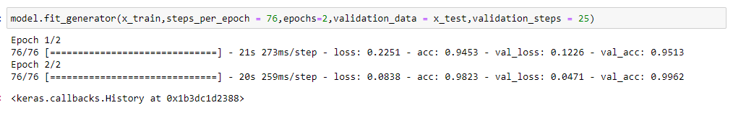
Evaluation Methodology
Accuracy
Please refer the image below.
This is the number of correctly predicted data points out of all.

